Slide 1
CSE 471 Project 3
James Dodge, Edward Maxwell, James Torres, Wyatt Roehler, Kiera Wheatley

Slide 2

Player
Player controls a ship
Ship can move left to right and fire rockets

Slide 3
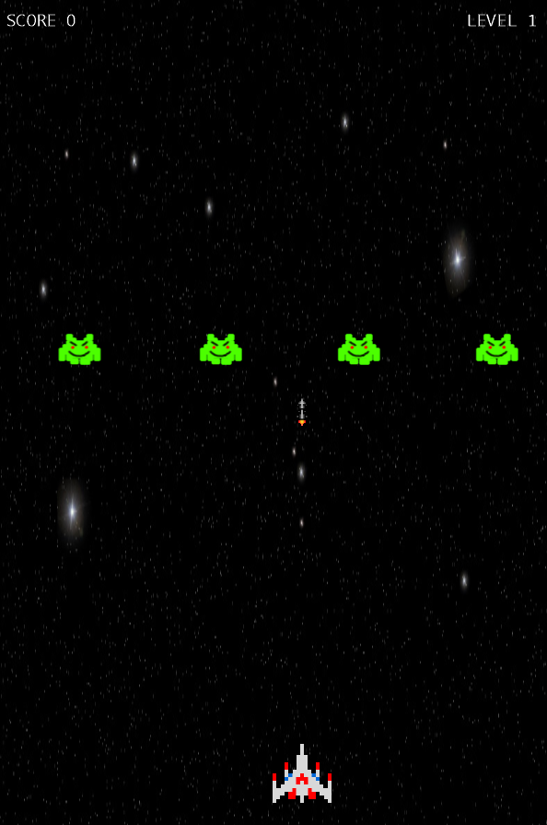
Controls
Left arrow key – Move left
Right arrow key – Move right
Space bar – Fire rocket

Slide 4




Levels
All enemies defeated → advance to next level
Enemies become faster
Enemy sprites change on certain levels
Enemies begin to shoot faster

Slide 5
Rockets
Enemy rockets are slower then ship rockets
Only ship rockets can destroy enemy
Ship has a limit to number of rockets allowed on a screen at a given time

Slide 6


Sound
Game background music – Galaga 88 Galactic Dancing Big Band Jazz
Source: https://www.youtube.com/watch?v=HOwH7Ftf71w
Rocket Fire sound effect
Rocket Hit sound effect
Sound effects taken from: soundbible.com and audioblocks.com

Slide 7
Game Over
Game over is determined on multiple factors
If the enemy missile overlaps with the ship
The ship overlaps a enemy
The enemy has reached a level equal to or below the ship

